Slide 1
VLANs

Slide 2
VLAN Trunks (1 of 2)
Each port on a switch that supports VLANs is configured as one of two types of VLAN ports:
Access port – connects the switch to a host
Trunk port – connects the switch to a networking device such as a router or another switch and manages traffic from multiple VLANs

Slide 3
VLAN Trunks (1 of 2)
A trunk is a single physical connection between switches through which many logical VLANs can transmit and receive data
Trunking protocols assign and interpret VLAN tags in Ethernet frames
Cisco’s VTP (VLAN trunking protocol) is the most popular protocol for exchanging VLAN information over trunks
VTP allows changes to a VLAN database on one switch, called the stack master, to be communicated to all other switches in the network

Slide 4
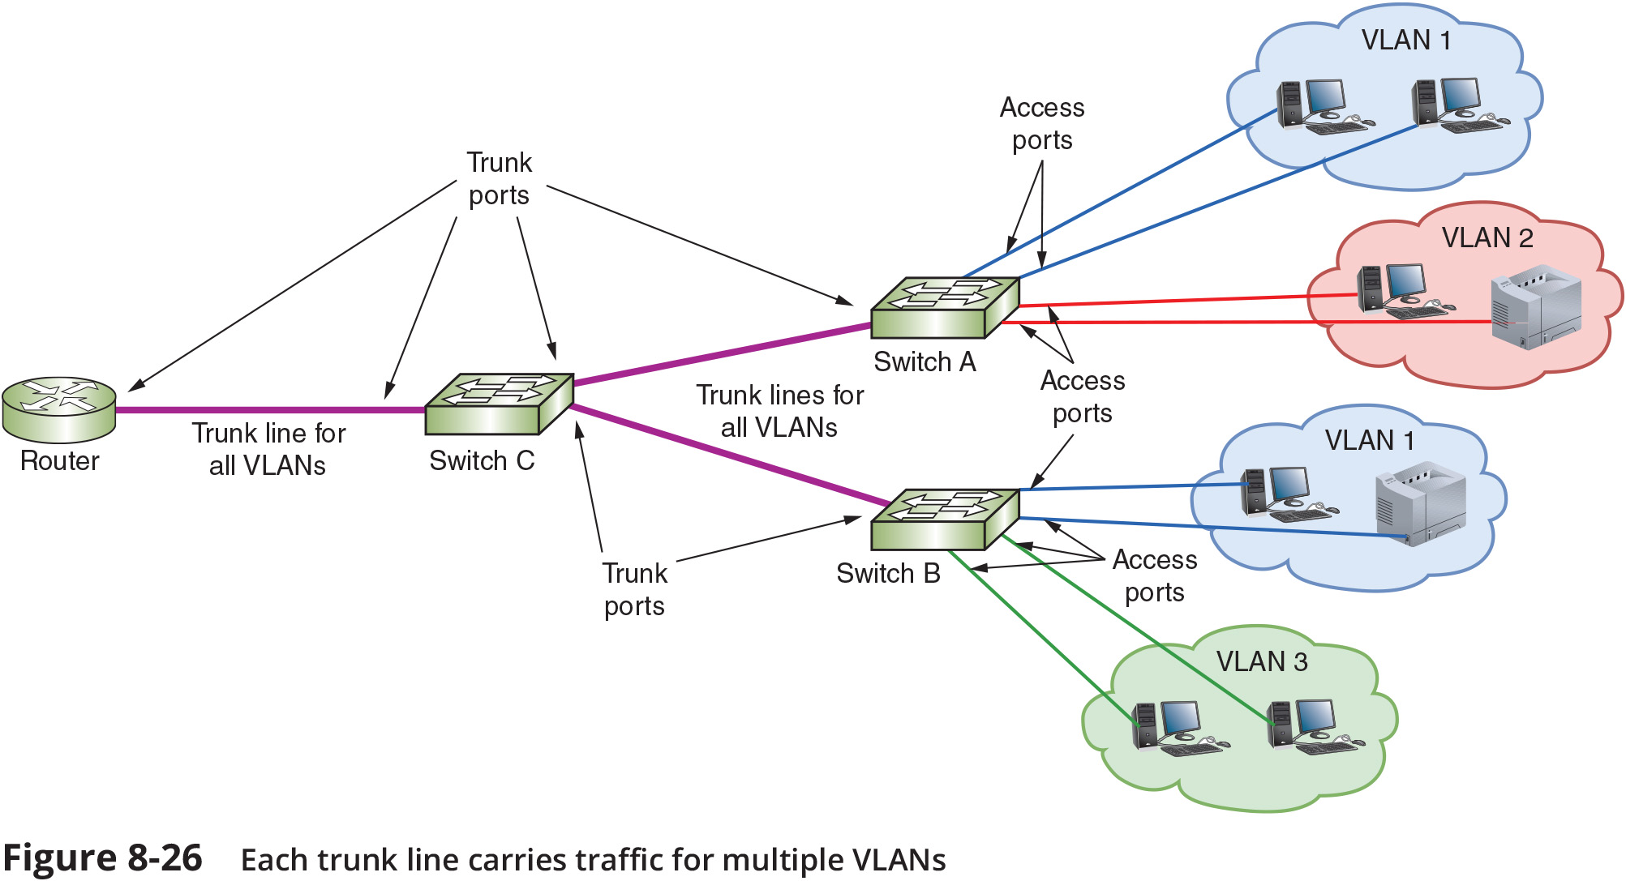
VLAN Trunks (2 of 2)

Slide 5
VLANs and Subnets (1 of 3)
In most situations, each VLAN is assigned its own subnet of IP addresses
The sample network in Figure 8-27, on the following slide, is divided into subnets
The router sees three logical LANs connected to a single router port

Slide 6
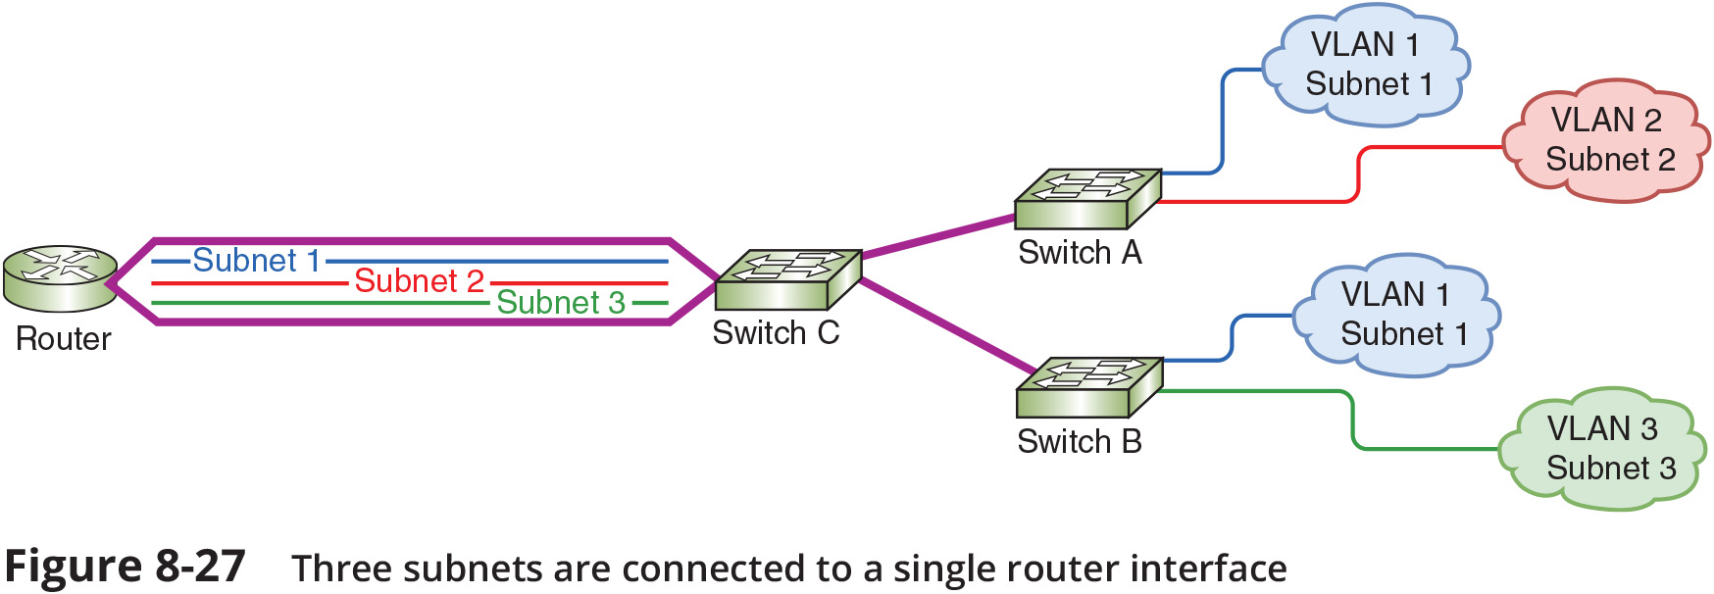
VLANs and Subnets (2 of 3)

Slide 7
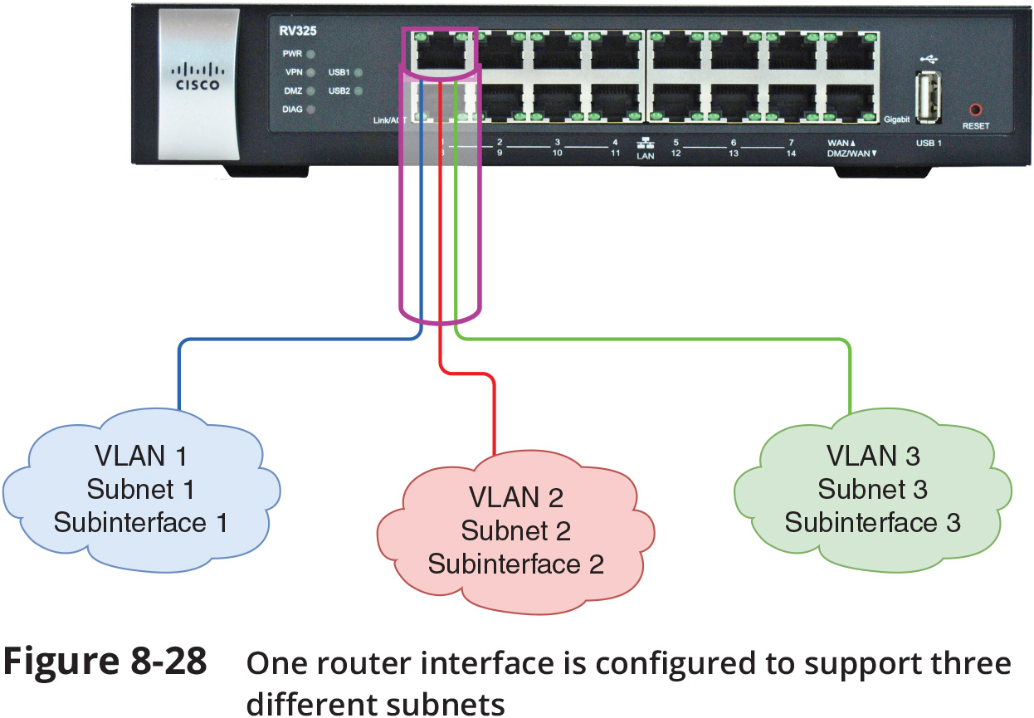
VLANs and Subnets (3 of 3)

Slide 8
Types of VLAN (1 of 2)
Common VLAN types include the following:
Default VLAN – typically preconfigured on a switch and initially includes all switch ports
Native VLAN – receives all untagged frames from untagged ports
Data VLAN – carries user-generated traffic, such as email, web browsing, or database updates
Management VLAN – can be used to provide administrative access to a switch
Voice VLAN – supports VoIP traffic
Private VLAN – partitions a VLAN broadcast domain into subdomains
Two types of secondary VLANs are:
Isolated VLAN
Community VLAN

Slide 9
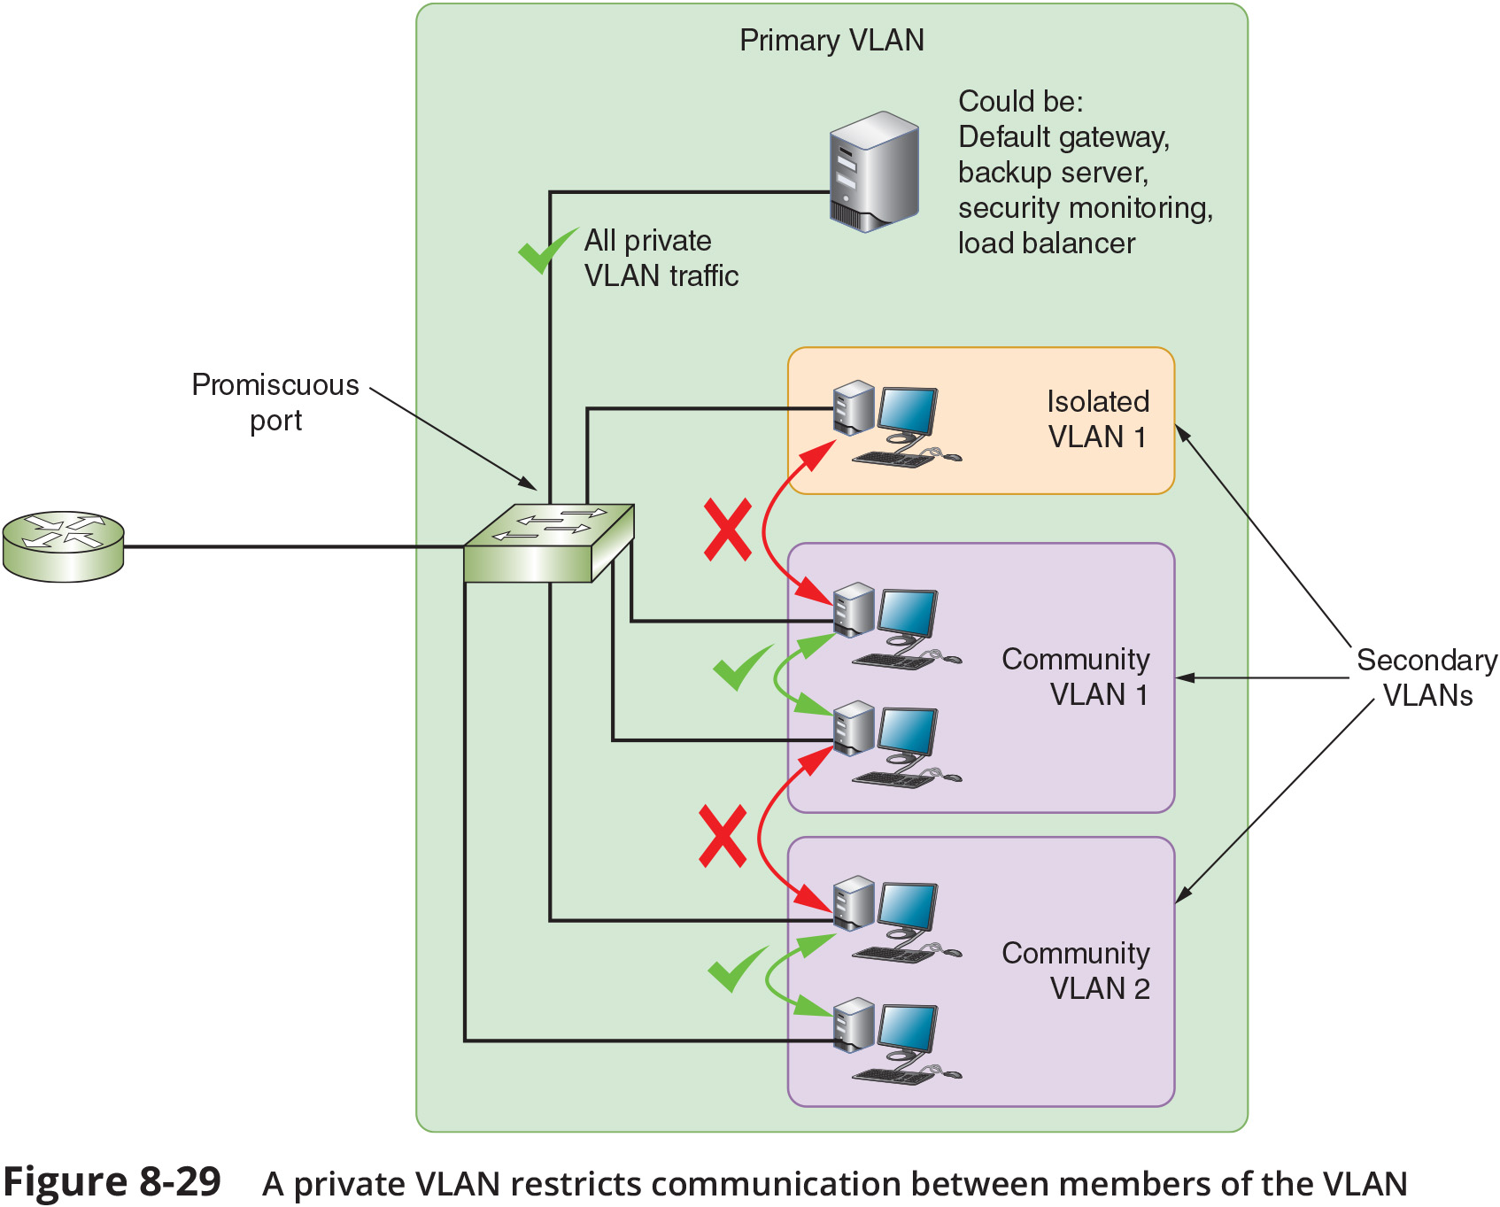
Types of VLAN (2 of 2)

Slide 10
View Configured VLANs (1 of 2)
Once you create a VLAN, you maintain it via switch software
Figure 8-30 illustrates the output of a show vlan command on a Cisco switch
This command is used to list the current VLAN recognized by a switch

Slide 11
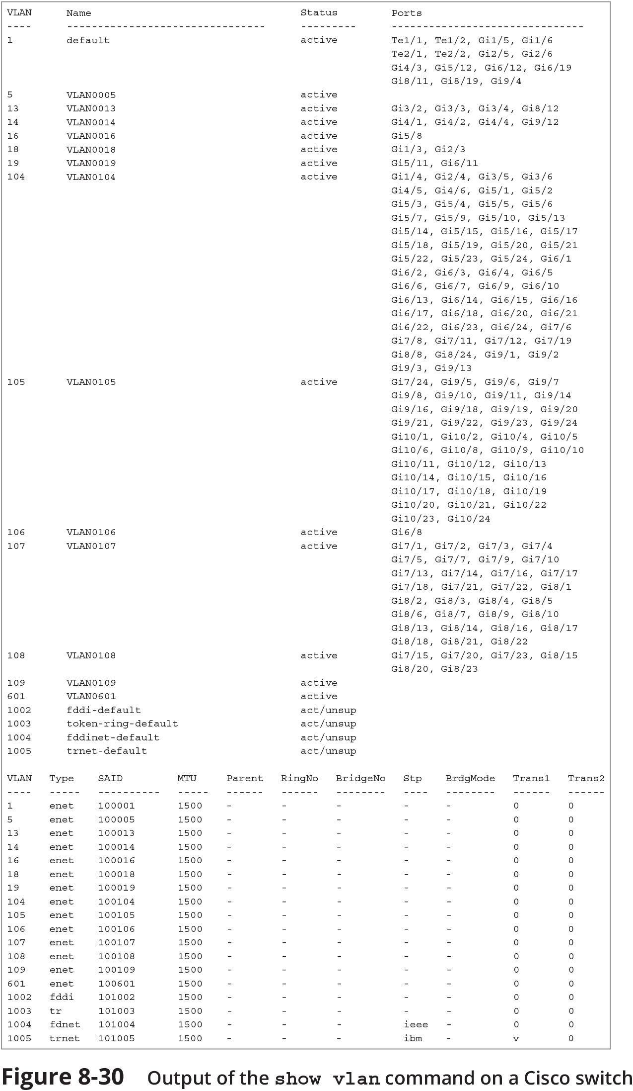
View Configured VLANs (2 of 2)
Figure 8-30 Output of the show vlan command on a Cisco switch

Slide 12
Dynamic VLAN Assignment
A device might receive a dynamic VLAN assignment according to the following:
Client device information, such as MAC address or location
Authentication processes in cooperation with a RADIUS server can be used to distinguish which traffic should be assigned to which VLANs
Devices that have not yet authenticated to the network or who authentication failed can be placed in a quarantine VLAN
All WLAN traffic might be grouped within the same VLAN

Slide 13
Troubleshoot and Secure VLANs (1 of 2)
Common configuration errors include the following:
Incorrect VLAN assignment – can happen due to a variety of situations
Incorrect port mode – switch ports connected to endpoints should nearly always use access mode
VLAN isolation – you can potentially cut off an entire group from the rest of the network
VLAN hopping occurs when an attacker generates transmissions that appear to belong to a protected VLAN
The attacker then crosses VLANs to access sensitive data or inject harmful software
There are two approaches to VLAN hopping:
Double tagging
Switch spoofing

Slide 14
Troubleshoot and Secure VLANs (2 of 2)
Mitigation efforts to reduce the risk of VLAN hopping include the following:
Don’t use the default VLAN
Change the native VLAN to an unused VLAN ID
Disable auto-trunking on switches that don’t need to support traffic from multiple VLANs
On switches that carry traffic from multiple VLANs, configure all ports as access ports unless they are used as trunk ports
Specify which VLANs are supported on each trunk instead of accepting a range of all VLANs
Use physical security methods such as door locks to restrict access to network equipment

